Slide 1

Southeast University
Presentation On
AutoRad-Lung: A Radiomic-Guided Prompting Autoregressive Vision-
Language Model for Lung Nodule
Malignancy Prediction
Presented by Farhana Jannath Oishi & Fahim

Slide 2

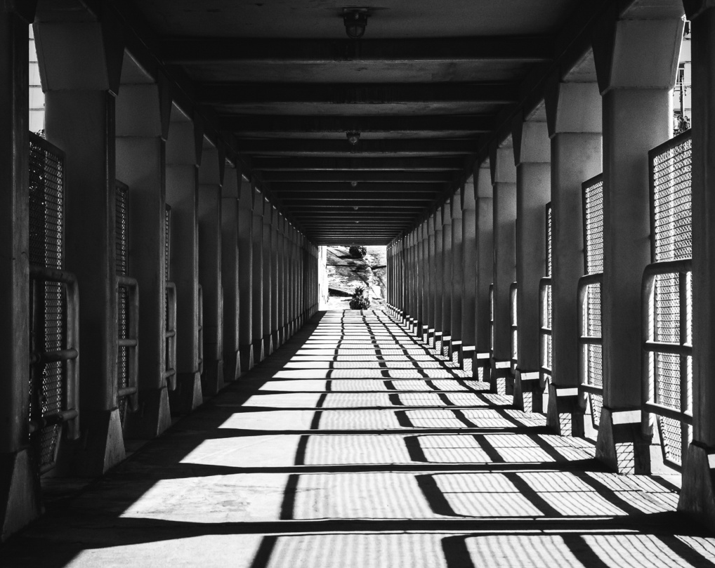
ABSTRACT
Title: AutoRad-Lung: A Radiomic-Guided Prompting Autoregressive Vision-Language Model
Subtitle: For Lung Nodule Malignancy Prediction
Authors: Sadaf Khademi, Mehran Shabanpour, Reza Taleei, Anastasia Oikonomou, Arash Mohammadi
01

Slide 3
OVERVIEW
01
Introduction
05
09
Dataset
Proposed Solution
02
ABSTRACT
06
Methodology
Result
10
03
Overview
07
11
Conclusion
Framework
04
Limitations
08
Key Innovations
02

Slide 4
Limitations of Existing CLIP-based Models
1
Dependence on radiologist annotations (subjective, error-prone).
2
Text info used only during training, not at inference.
3
CNN-based vision encoder with random initialization → ignores prior knowledge.
04

Slide 5
Proposed Solution:
AutoRad-Lung
Couples autoregressive VLM (AIMv2) with hand-crafted Radiomics prompts.
Radiomics guide context-specific prompt generation.
Captures pixel-level differences in small, irregular lung nodules.
Enables textual input at both training & inference.
07

Slide 6
METHODOLOGY
Inputs: CT nodule slices + Radiomic features.
Vision Encoder: AIMv2 (autoregressive image model).
Text Encoder: CLIP-based GPT2-like.
MetaNet: Transforms Radiomics → context tokens.
Fusion: Aligns image & text features with cosine similarity.
09

Slide 7
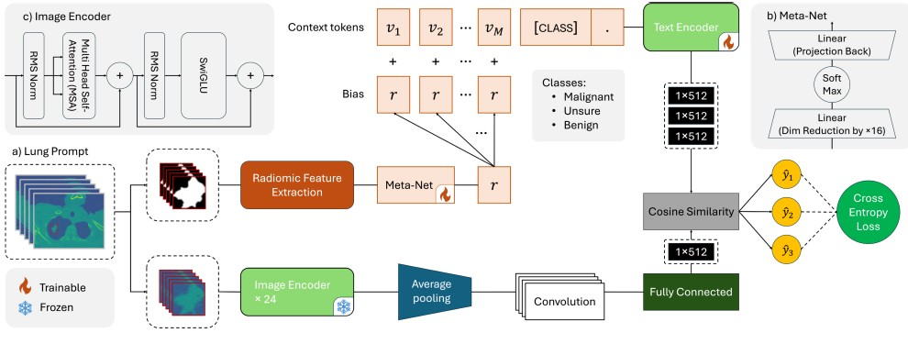
Methodology/ FRAMEWORK
We consider the problem of lung nodule classification based on a dataset constructed
as D = {I,Y, C,R}, where I = {Ij}Ni
j=1 is the input set of Ni CT
images. Set Y = {yj}Ni
j=1 consists of Nc nodule classification labels for (1 ≤
yj ≤ Nc). Set C = {ck}Nc
k=1 is text embeddings associated with the Nc nodule
classes. Finally, R = {rj}Ni
j=1 is the set of Radiomics extracted from each image,
Ij , where rj ∈ RNr×1 with Nr being the dimension of the extracted Radiomics
vector. The task at hand is to learn a context prompt that guides the model
based on hand-crafted nodule characteristics, enabling it to identify ambiguous
nodules that require further clinical review.
Problem Formulation
Proponents
06

Slide 8
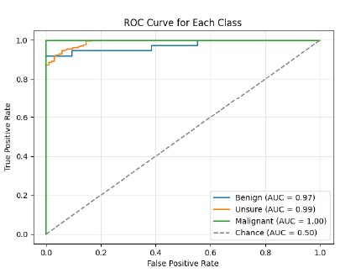
Key Innovations
1
First model to integrate autoregressive pre-trained VLM + Radiomics prompts.
2
Conditional Context Optimization: dynamically generated prompts.
3
Eliminates reliance on subjective radiologist annotations.
4
Enhanced detection for “unsure” class → critical in
medical use
11

Slide 9
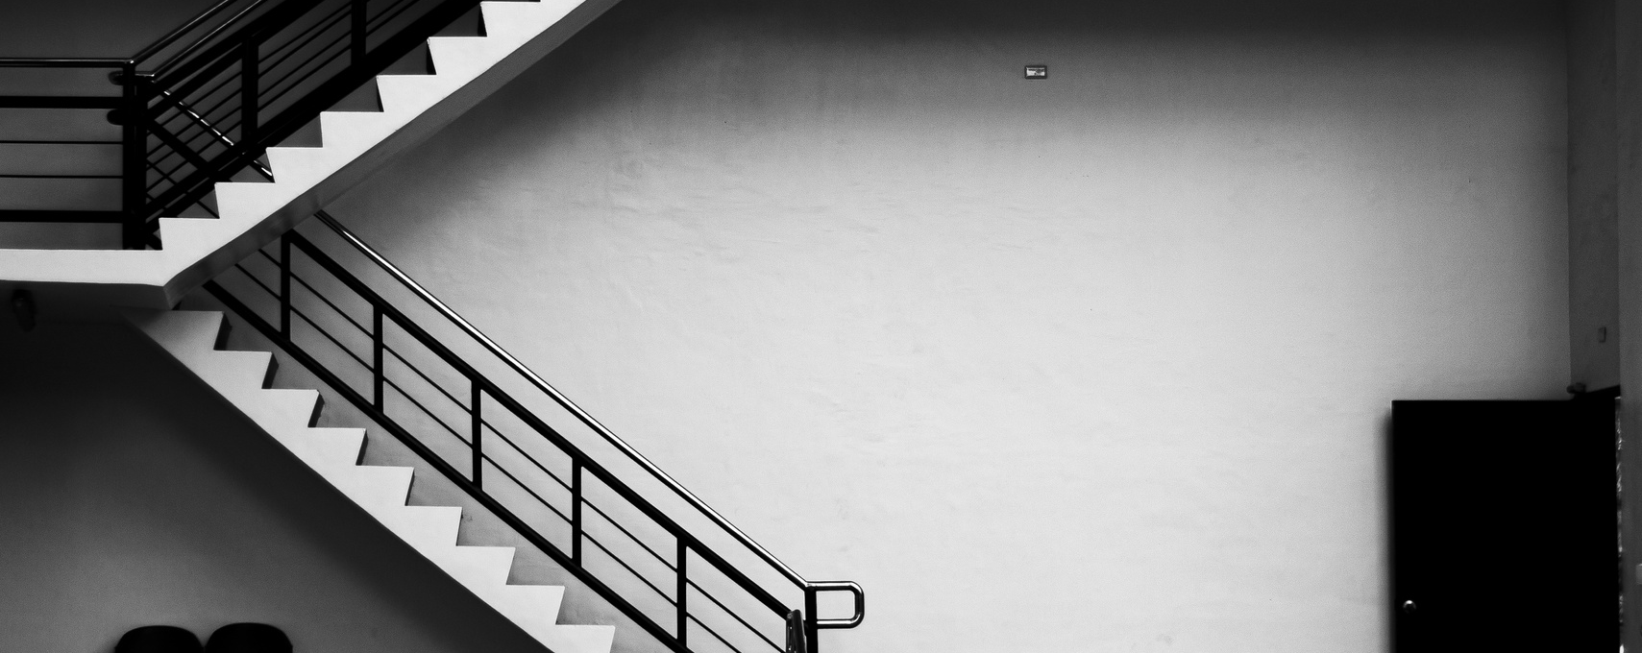
Southeast University
Dataset & Experiments
Dataset: LIDC-IDRI (1,010 patients, CT scans).
3-class classification: Benign, Malignant, Unsure.
Training: PyTorch, NVIDIA RTX 3090, 5-fold cross-validation.
08

Slide 10
Results
Accuracy improvement: +6% vs baselines.
Recall & F1 gains: +16% recall, +24% F1 (for “unsure” class).
ROC curves & F1 heatmaps → strong generalization.
Best performance with ~50 context tokens.
13

Slide 11


CONCLUSION
AutoRad-Lung improves lung nodule malignancy prediction.
Key strengths: Pixel-level details + Radiomic prompts + autoregressive VLM.
Especially effective in uncertain/ambiguous cases.
Future: Extend to broader medical imaging applications.
12

Slide 12

THANK
YOU
Presented Farhana Jannath Oishi & Fahim
Southeast University

